Slide 1
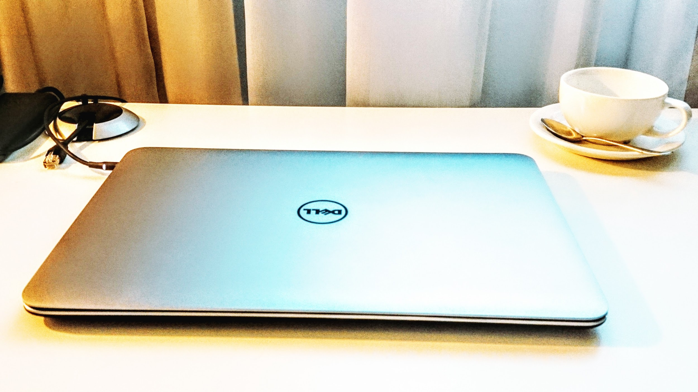

Massive Enterprise Product Migration to OSGi
Raymond Auge
raymond.auge@liferay.com
Notes:
Migrating from monoliths to microservices is not just a trend, it's a strategy for saner, happier living.
- what migration strategy do you use?
Super bundle
Complete re-write
Embedded framework evolution
- services first!!!!

Slide 2

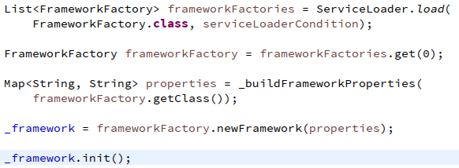
bootstrapping

Slide 3

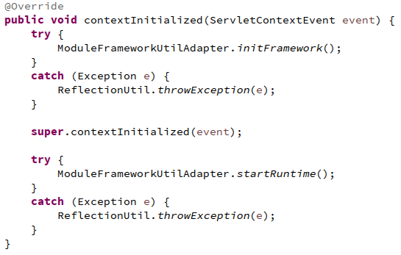
lifecycle of a WAR
Notes:
Migrating from monoliths to microservices is not just a trend, it's a strategy for saner, happier living. This talk is one company's story about such a migration; the joys, the pains, and the outcome and how OSGi microservices helped.

Slide 4

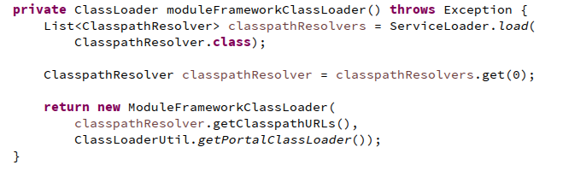
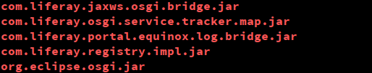
restricted view of the world
Notes:
Migrating from monoliths to microservices is not just a trend, it's a strategy for saner, happier living. This talk is one company's story about such a migration; the joys, the pains, and the outcome and how OSGi microservices helped.

Slide 5

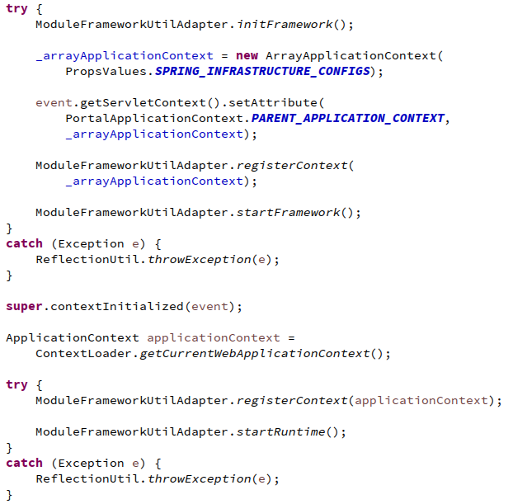
integrating spring, interleaving
Notes:
Migrating from monoliths to microservices is not just a trend, it's a strategy for saner, happier living. This talk is one company's story about such a migration; the joys, the pains, and the outcome and how OSGi microservices helped.

Slide 6
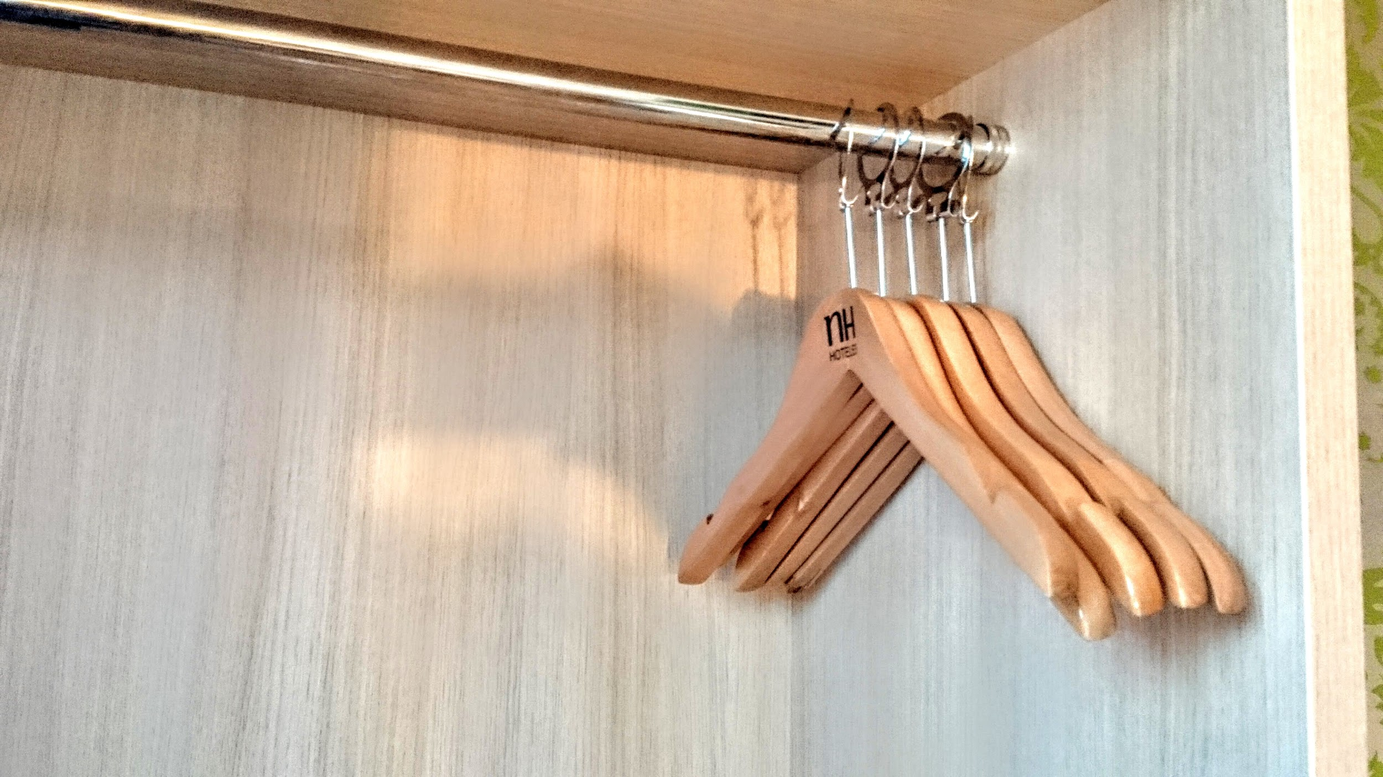
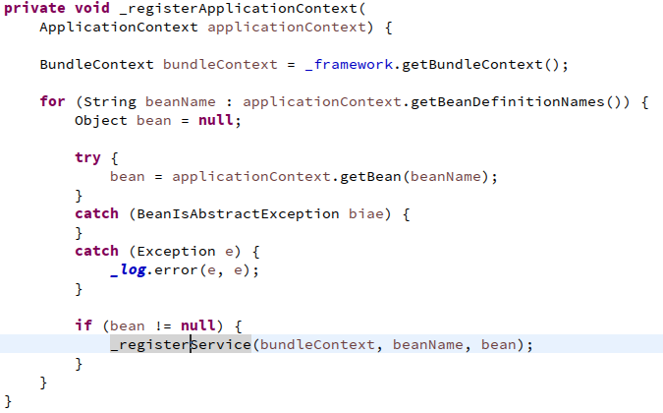
beans as services
Notes:
Migrating from monoliths to microservices is not just a trend, it's a strategy for saner, happier living. This talk is one company's story about such a migration; the joys, the pains, and the outcome and how OSGi microservices helped.

Slide 7
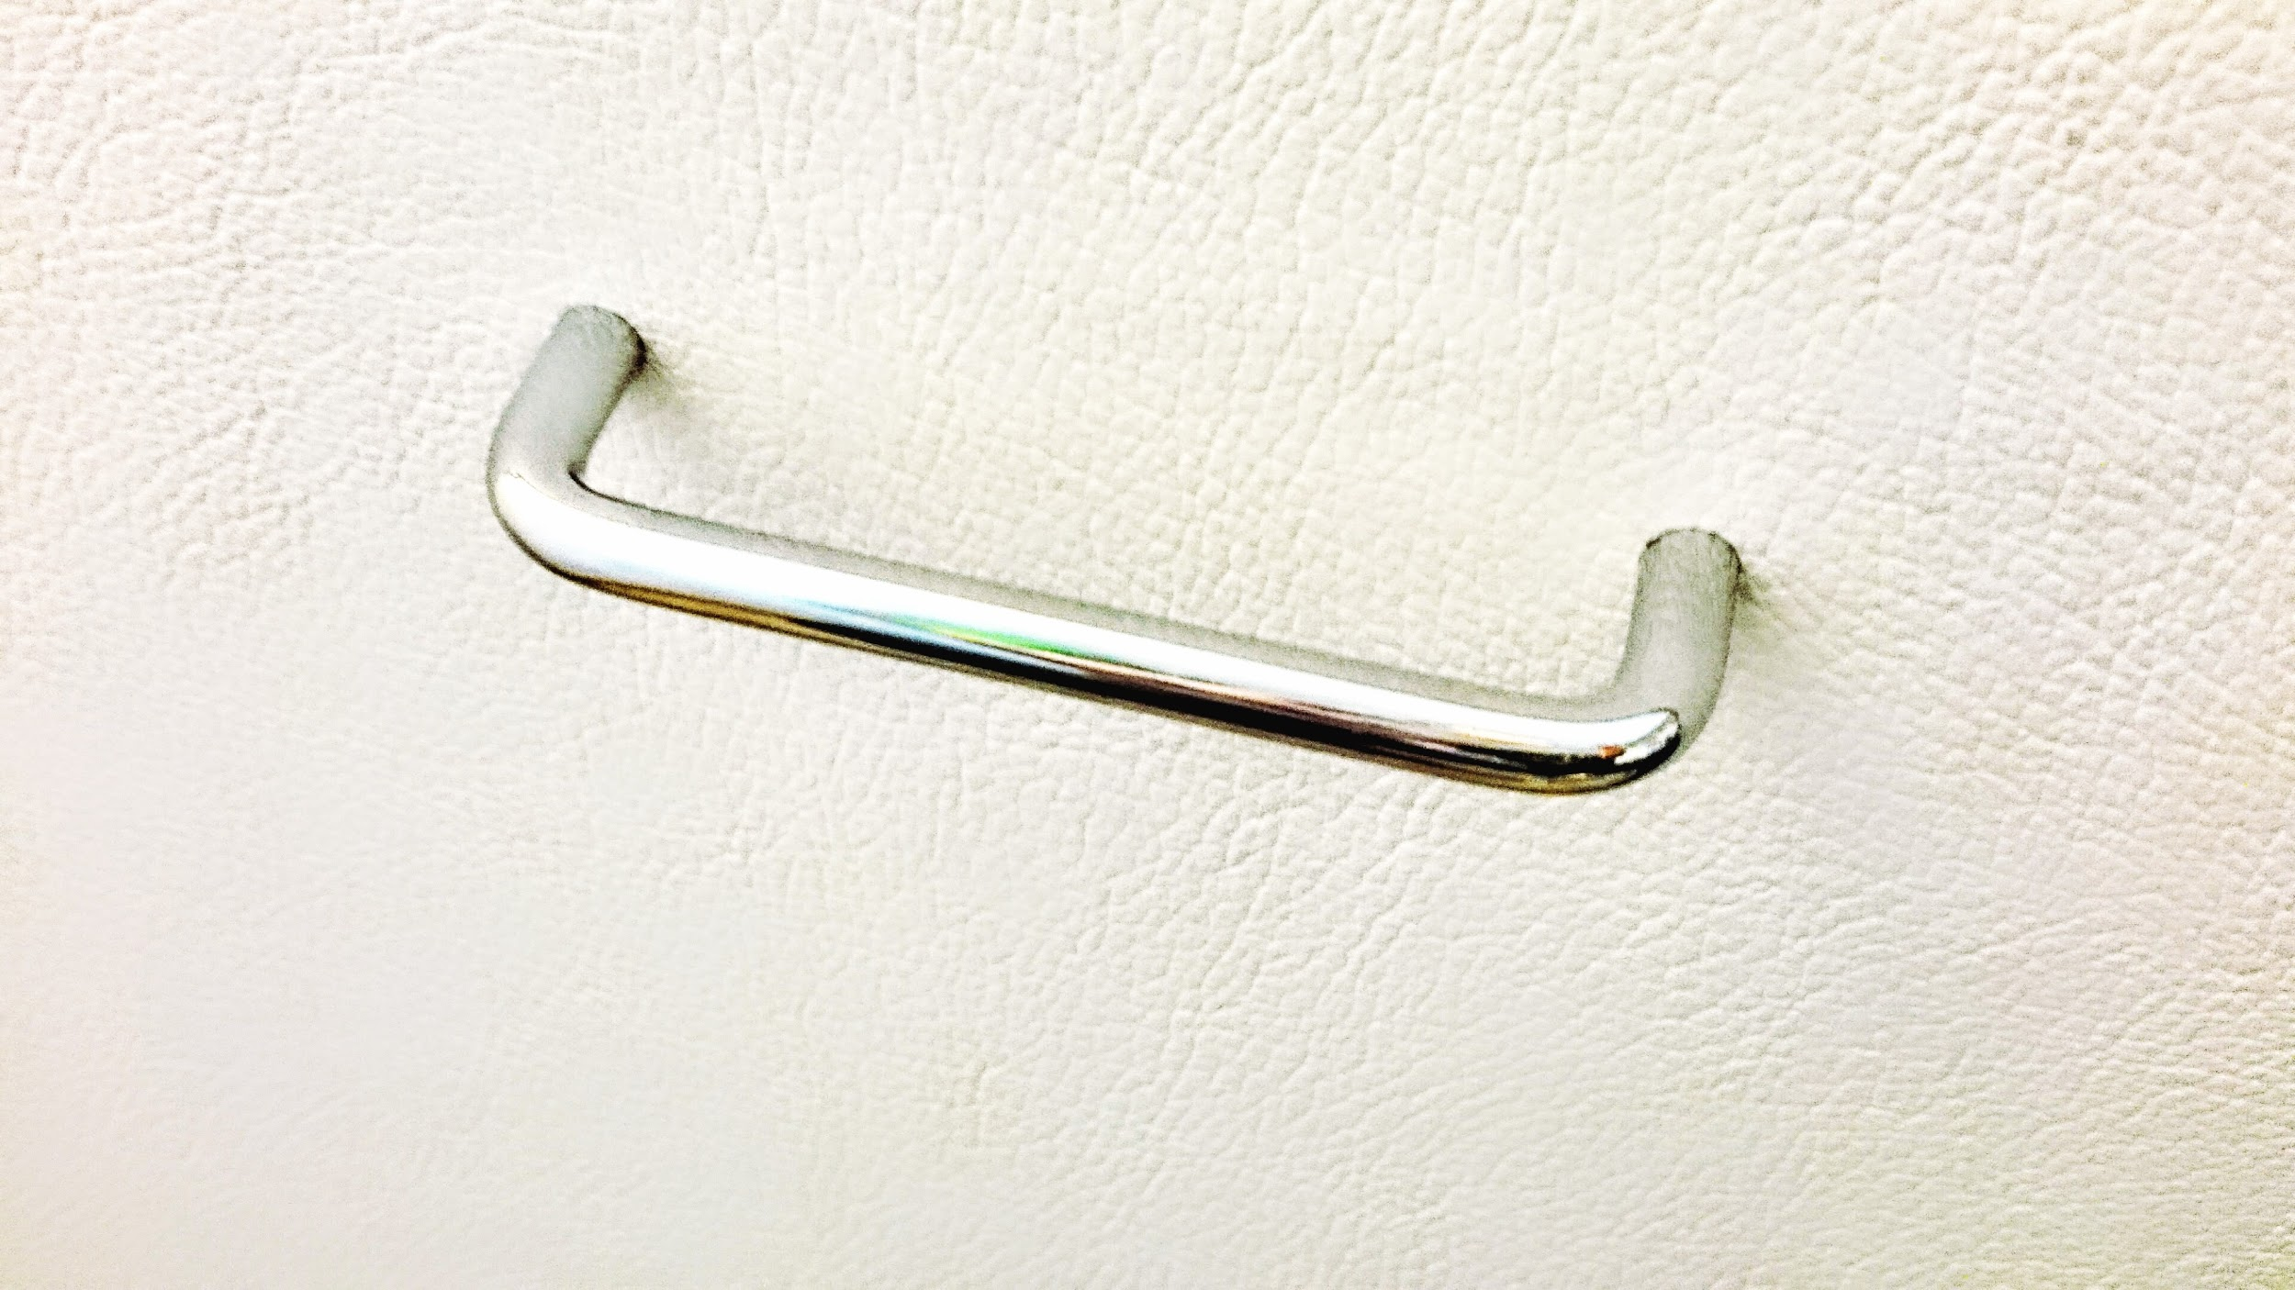
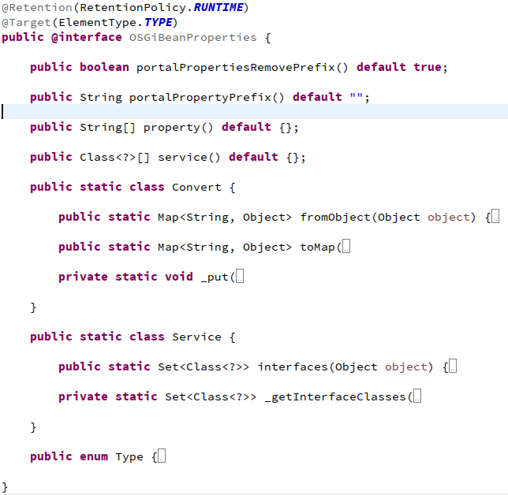
bean service properties
Notes:
Migrating from monoliths to microservices is not just a trend, it's a strategy for saner, happier living. This talk is one company's story about such a migration; the joys, the pains, and the outcome and how OSGi microservices helped.

Slide 8

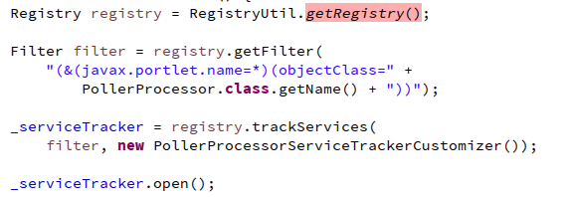
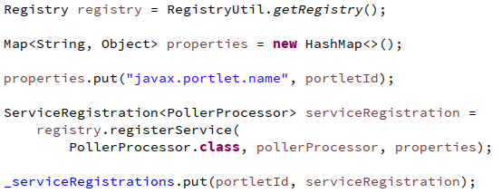
service registry from plain java
Notes:
Migrating from monoliths to microservices is not just a trend, it's a strategy for saner, happier living. This talk is one company's story about such a migration; the joys, the pains, and the outcome and how OSGi microservices helped.

Slide 9

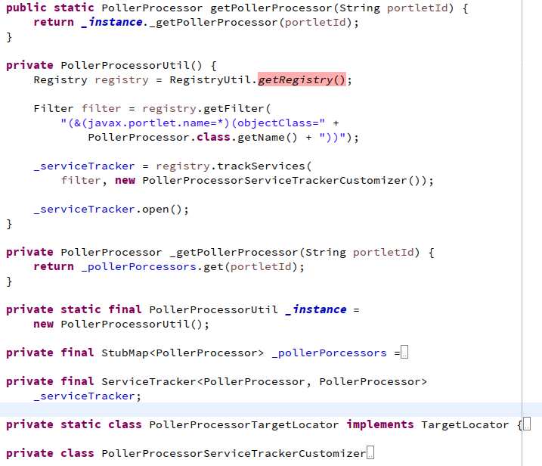
legacy integration with registry dynamics
Notes:
Migrating from monoliths to microservices is not just a trend, it's a strategy for saner, happier living. This talk is one company's story about such a migration; the joys, the pains, and the outcome and how OSGi microservices helped.

Slide 10

more to consider:
legacy packaging, WABs
legacy UI, JSPs
web resources
Thank you!
Notes:
Migrating from monoliths to microservices is not just a trend, it's a strategy for saner, happier living. This talk is one company's story about such a migration; the joys, the pains, and the outcome and how OSGi microservices helped.

